Slide 1
DATA 621 HW5
Using Wine Quality Measurement to Predict Sales
Joby John, Jun Pan
Version 05142019

Slide 2
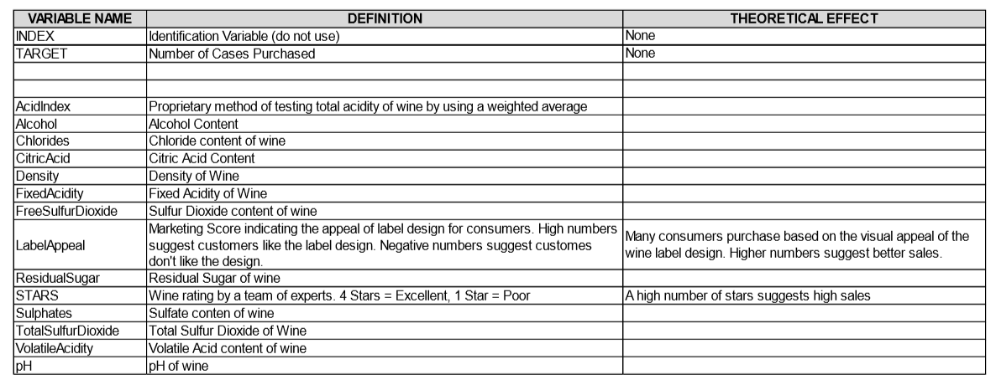

Slide 3
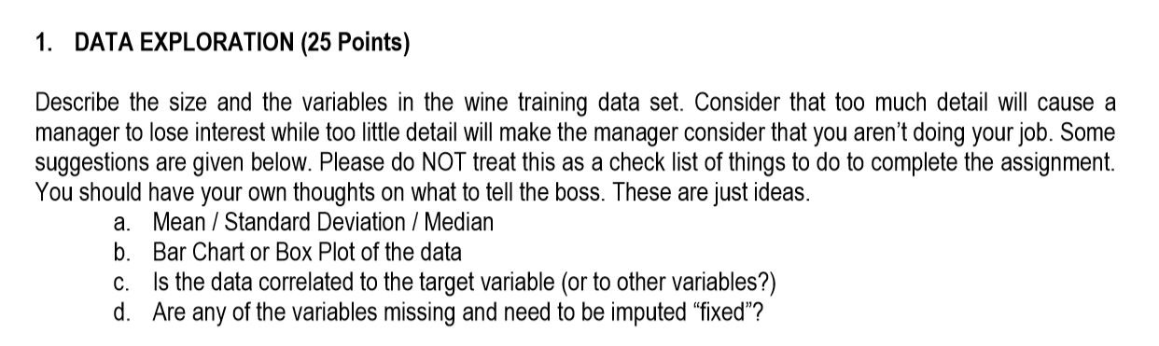

Slide 4
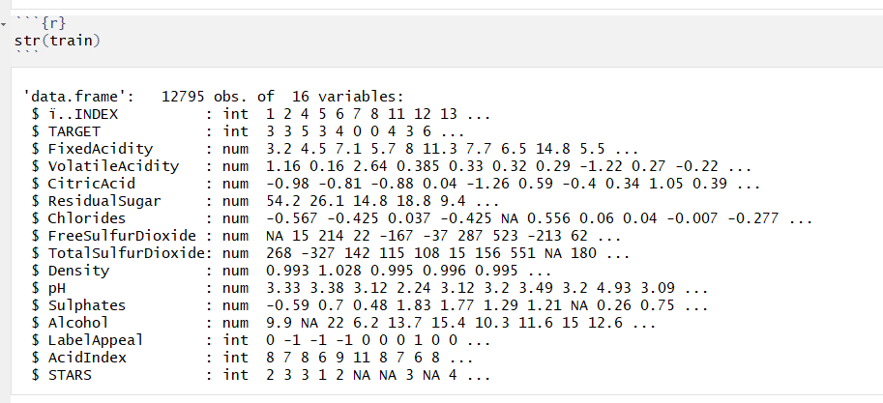
Overview Train Data
Train data has 12795 rows and 16 columns.
Besides, Label Appeal, AcidIndex and Stars are ordinal variables with transforming into integers. Other explanatory variables are numerical variables. TARGET is integer which records the number of box win being sold.

Slide 5
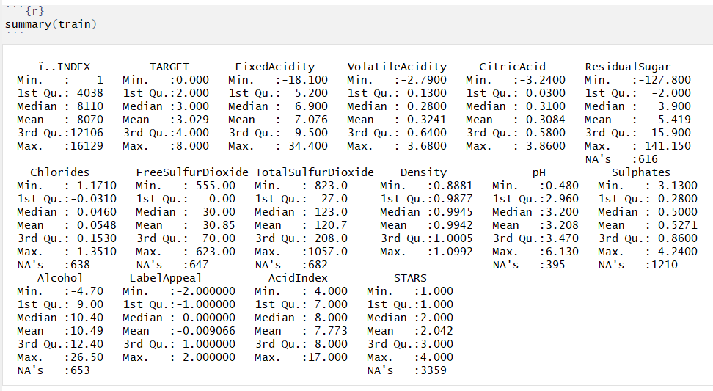
All independent variables are continous, except variables of `LabelAppeal`, `AcidIndex` and `STARS` are ordinal. These three ordinal variables represented by numeric values in logical order. The distances between categories/values can be considered equal . So these variables can be used in modeling as numeric variables.

Slide 6
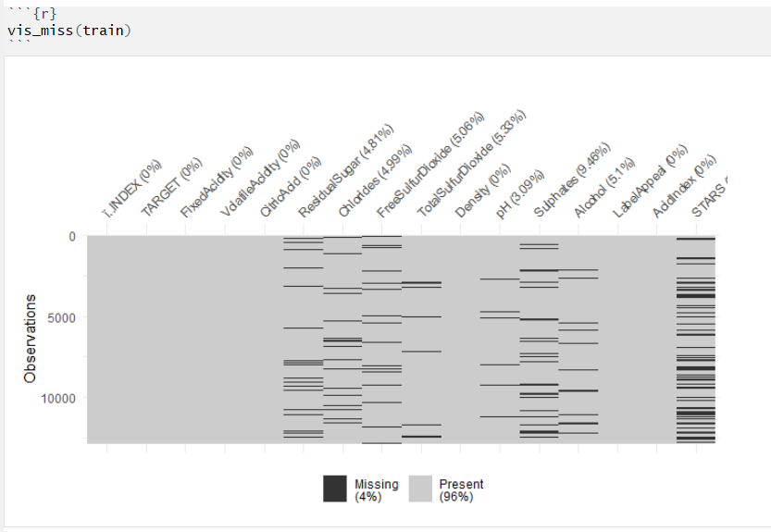
4% of Missing Data

Slide 7
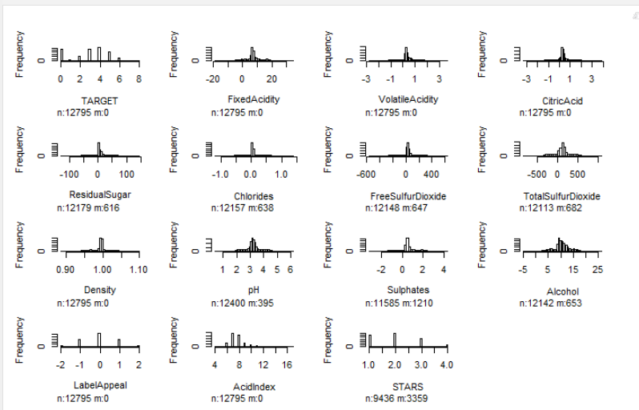
Histogram of all variables

Slide 8
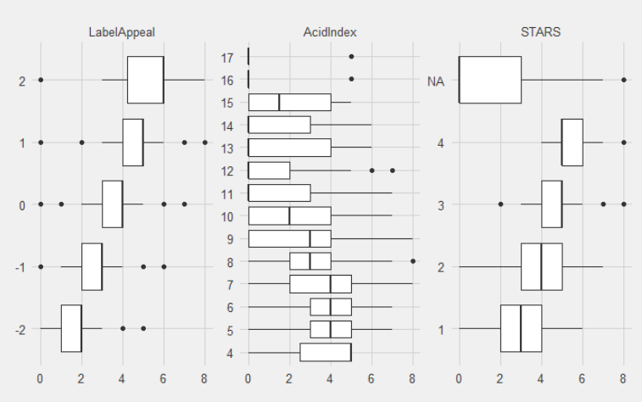
Box plot of 3 ordinal variables

Slide 9
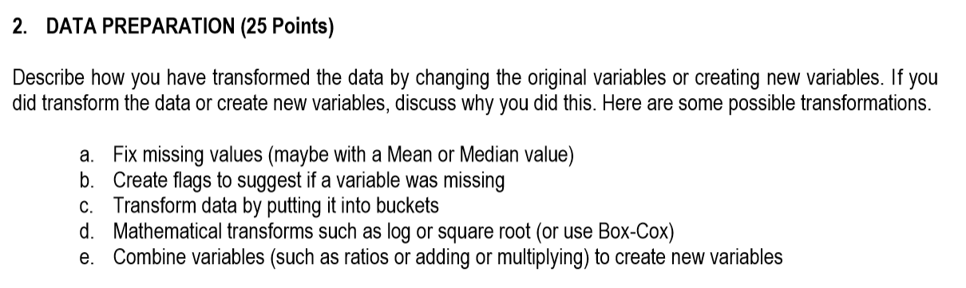

Slide 10
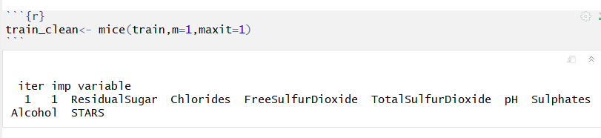
Using Mice Package for Missing Data

Slide 11
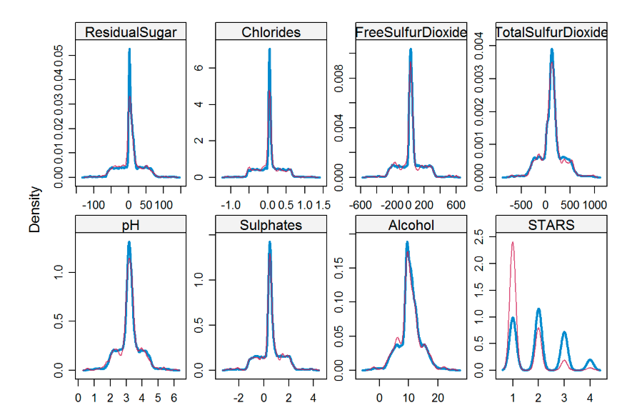
No Missing Data

Slide 12
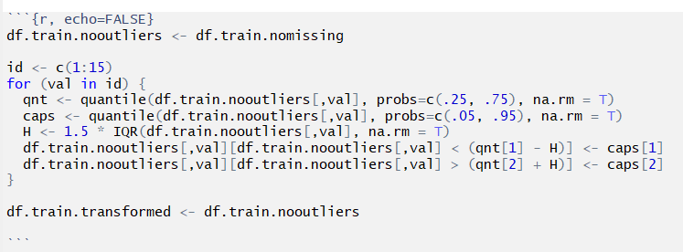
Treat Outliers
Any outliers outside of lower 1.5IQR would be capped at 5th %ile, and observations above the upper 1.5IQR would be capped at 95th %ile.

Slide 13
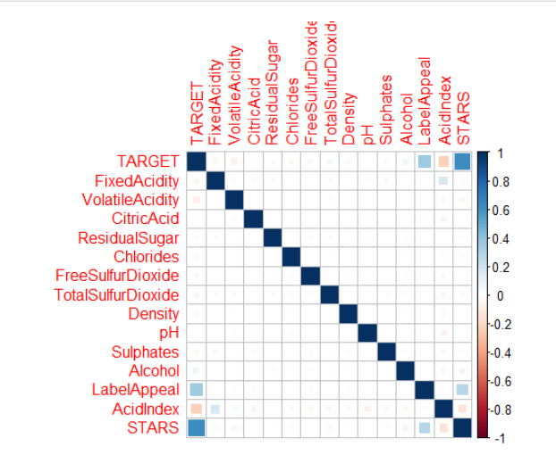
Correlation Plot

Slide 14
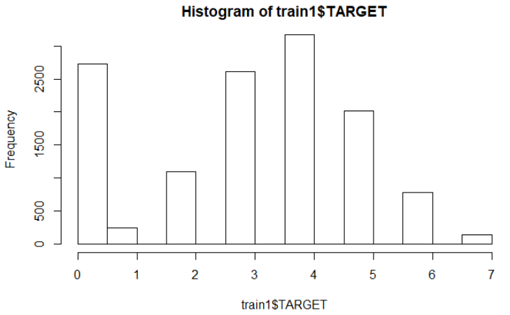

Slide 15
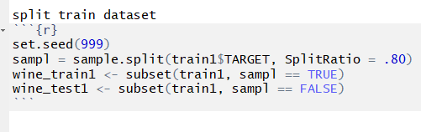
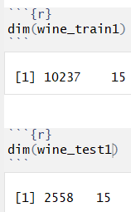
Split Train Data

Slide 16
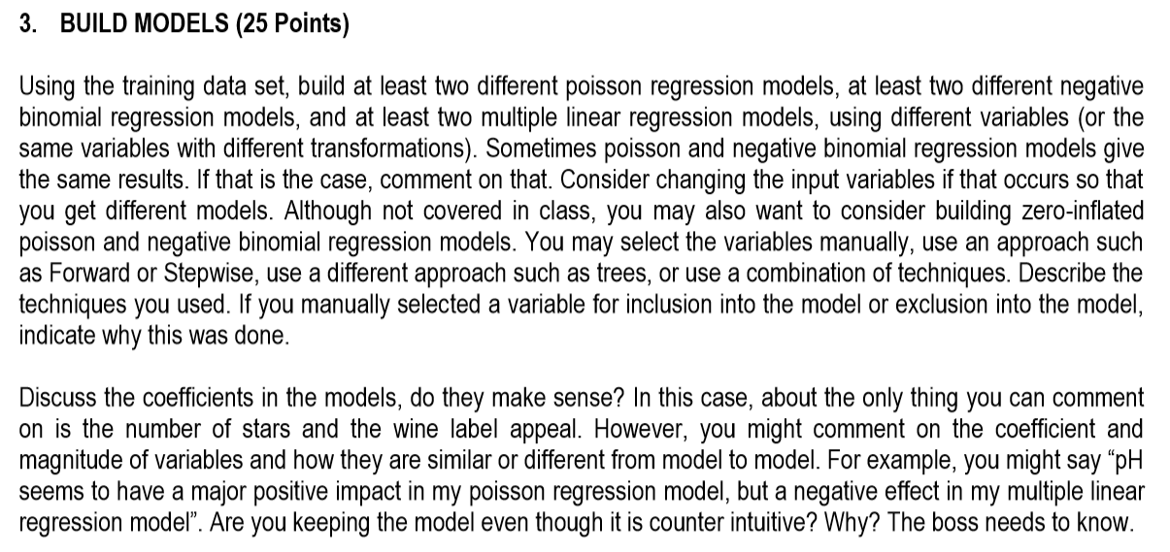

Slide 17
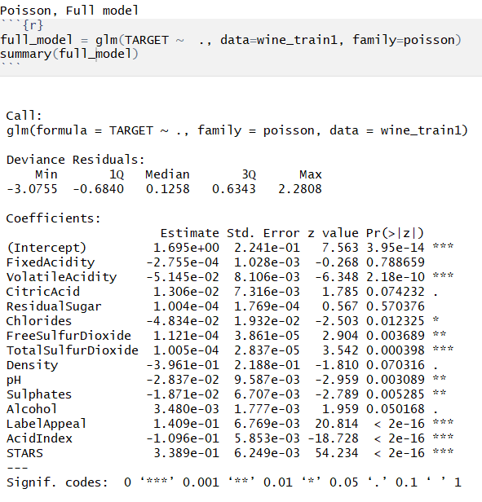
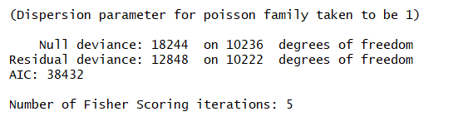
Poisson full_model

Slide 18
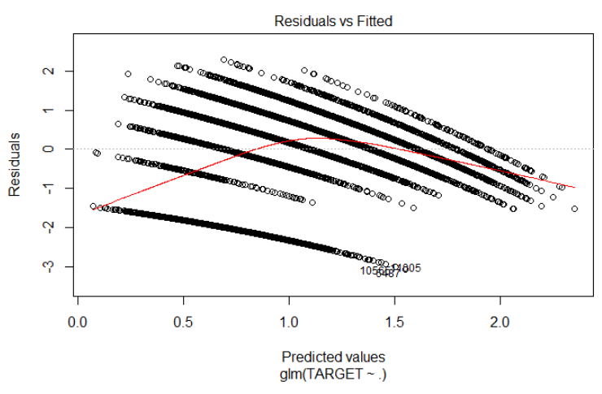
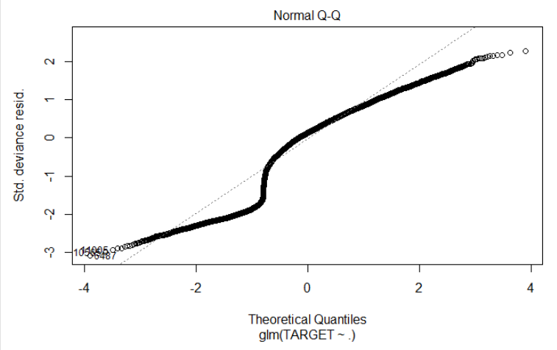
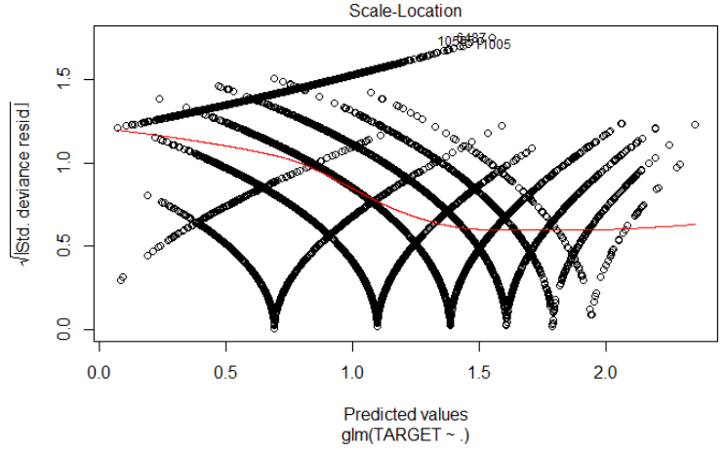
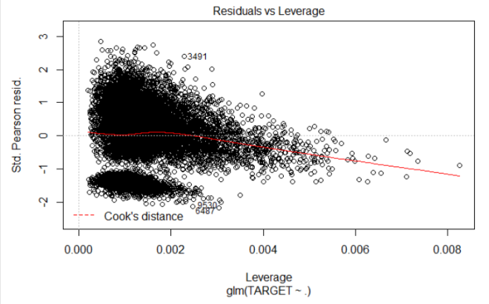
Plots of full_model

Slide 19
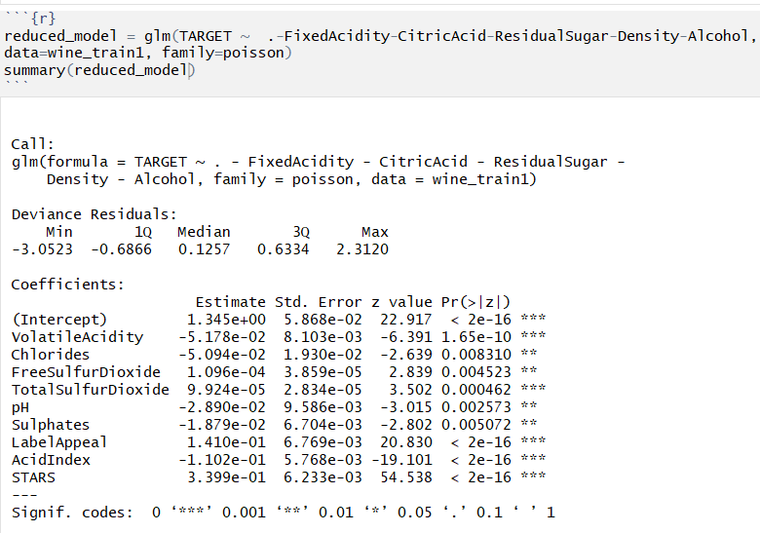
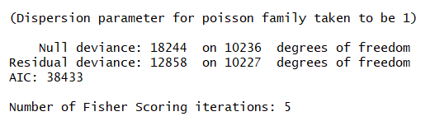
Poisson reduced_model

Slide 20
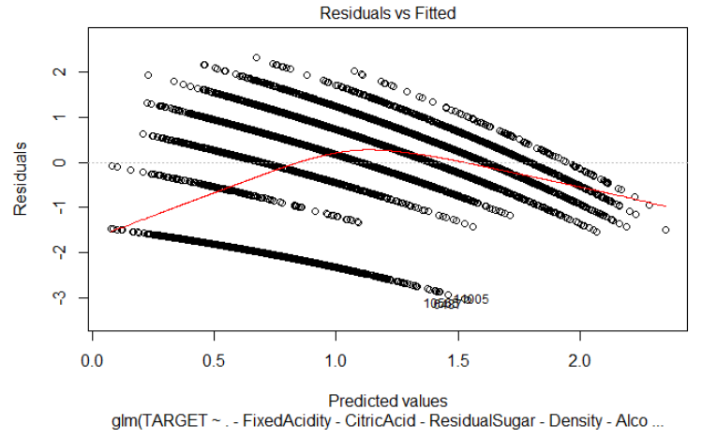
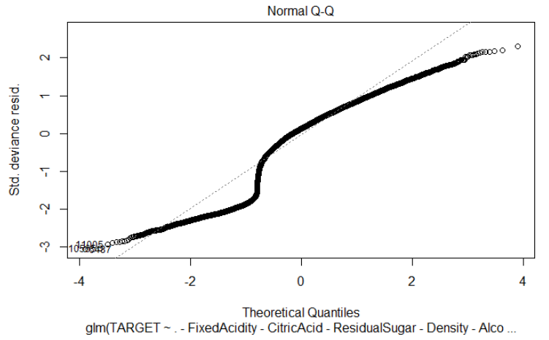
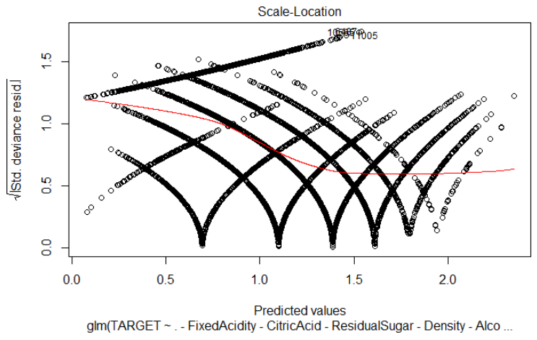
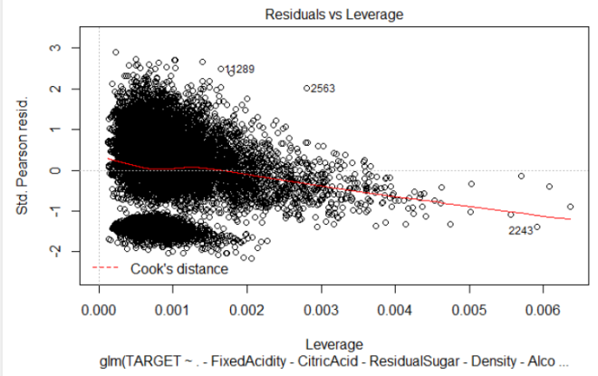
Plots of reduced_model

Slide 21
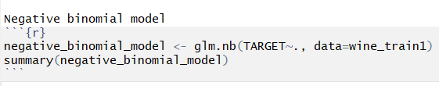
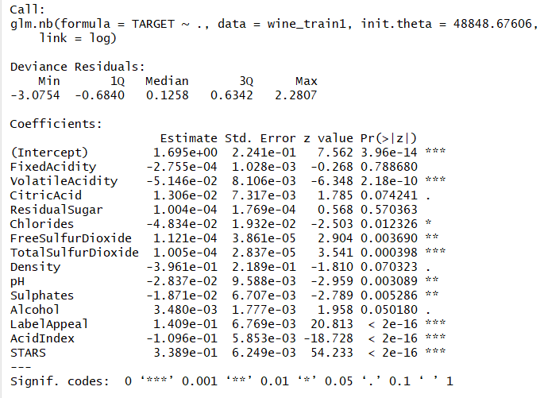
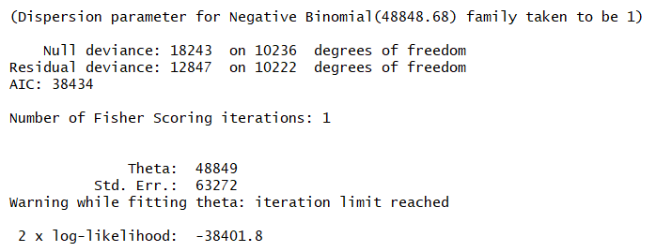
Negative Binomial Model

Slide 22
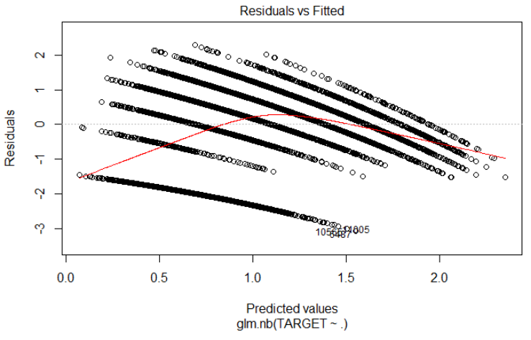

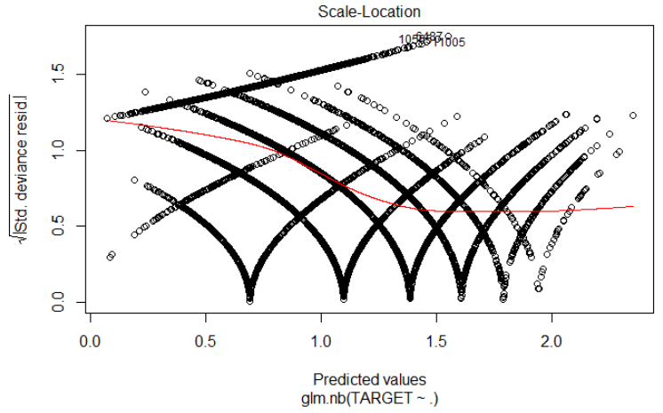
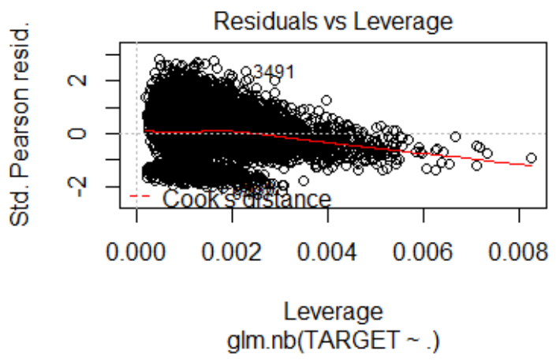
Plot of Negative Binomial Model

Slide 23

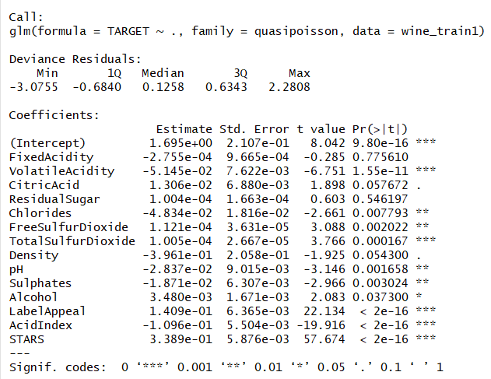
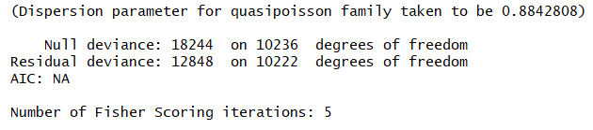
Quasi-Poisson Model

Slide 24
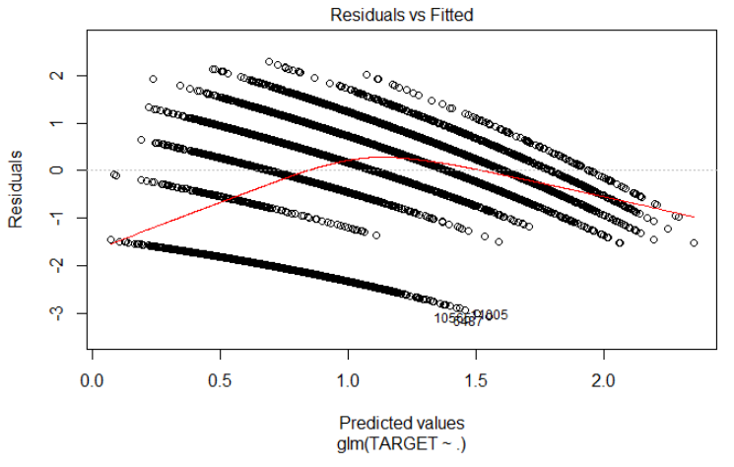

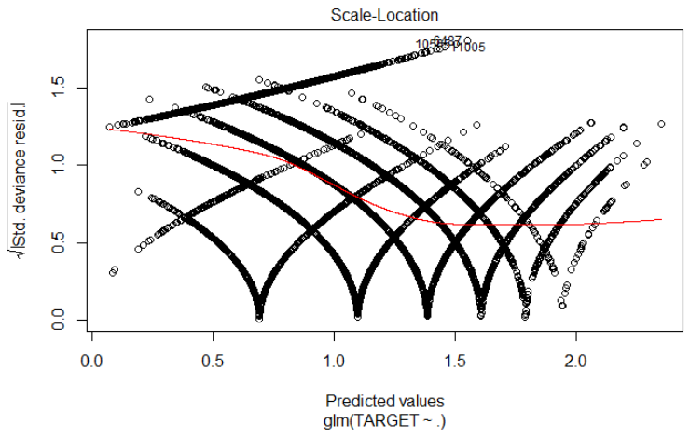
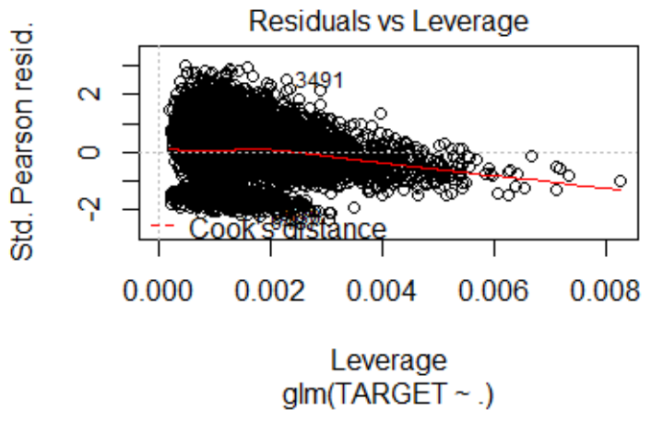
Plot of Quasi-Poisson Model

Slide 25
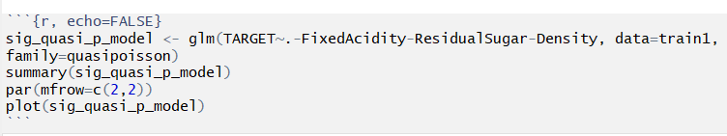
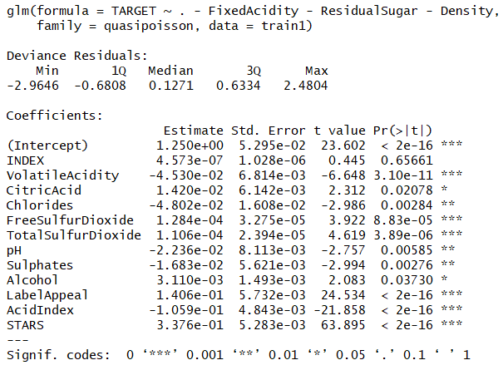
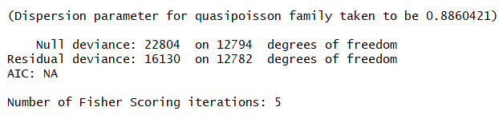
Sig Quasi Model(significant variables)

Slide 26
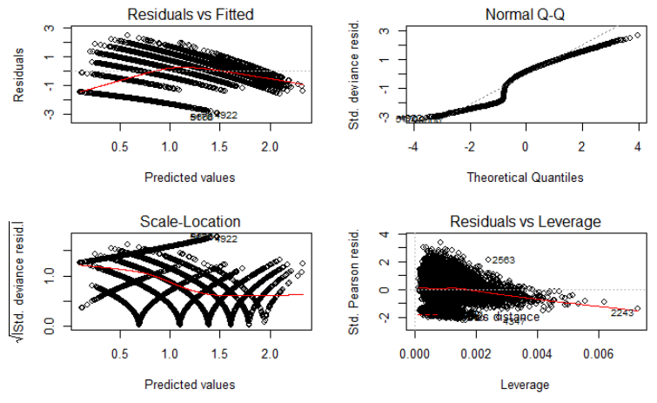

Slide 27
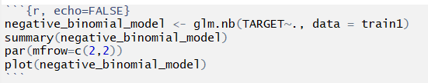
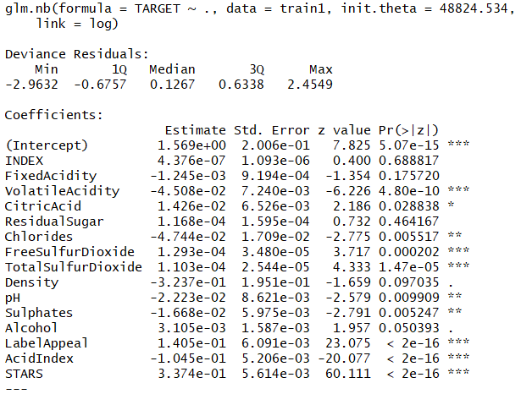

Negative binomial model

Slide 28
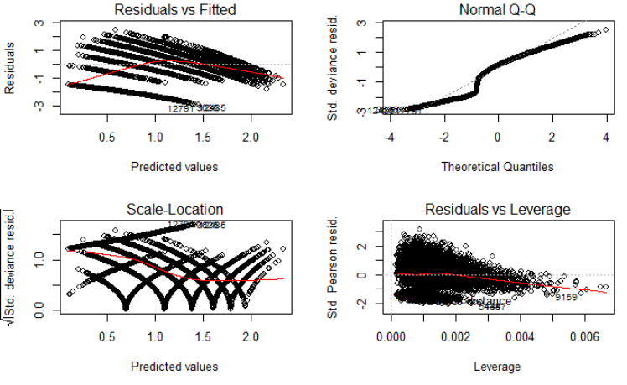

Slide 29
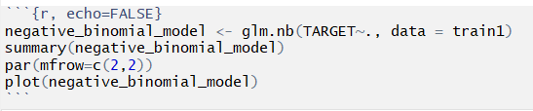
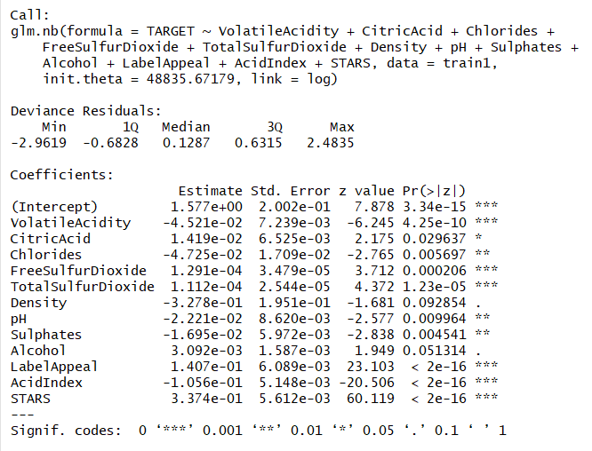
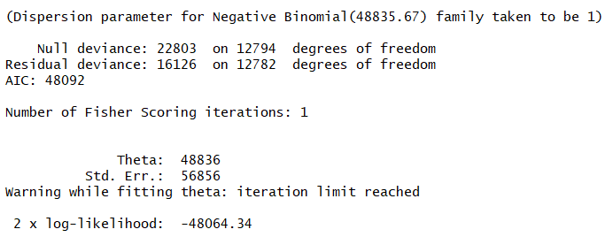
Stepwise negative binomial model

Slide 30
4. SELECT MODELS (25 Points)
Decide on the criteria for selecting the best count regression model. Will you select models with slightly worse performance if it makes more sense or is more parsimonious? Discuss why you selected your models.
For the count regression model, will you use a metric such as AIC, average squared error, etc.? Be sure to explain how you can make inferences from the model, and discuss other relevant model output. If you like the multiple linear regression model the best, please say why. However, you must select a count regression model for model deployment. Using the training data set, evaluate the performance of the count regression model. Make predictions using the evaluation data set.

Slide 31
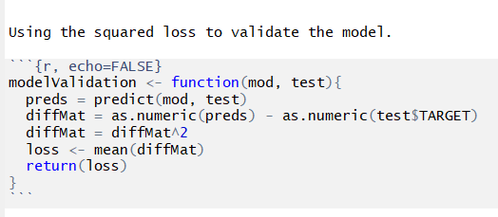

Using Squared Loss to Validate Poisson Model

Slide 32

Coefficients of Models

Slide 33


Using ANOVA to Evaluate Models

Slide 34
Sig_Quasi_P_Model is the Best
All models have similar NULL deviance and residual deviance values.
Also, predicted count for all the models do have similar distributions as seen according to the histograms.
Sig_quasi_p_model is simpler than quassi poisson model. We believe the sig_quasi_p_model models fits the data better than other models. Since we have under dispersion, we are not selecting negative binomial model.

Slide 35



